Slide 1
International study centre
Low level modelling, user interface and test modelling
Name : John Alamina
Email : john.alamina@hud.ac.uk

Slide 2
Activity Diagram
There are several subsets of diagrams under the UML such as structure diagrams, interaction diagrams and behavior diagrams.
Activity diagrams as well as use case and state machine diagrams are considered as behavior diagram.
Activity diagrams are the object-oriented equivalent of flowcharts
A major benefit of the activity diagram is that it helps to demonstrate the logic of an algorithm.

Slide 3
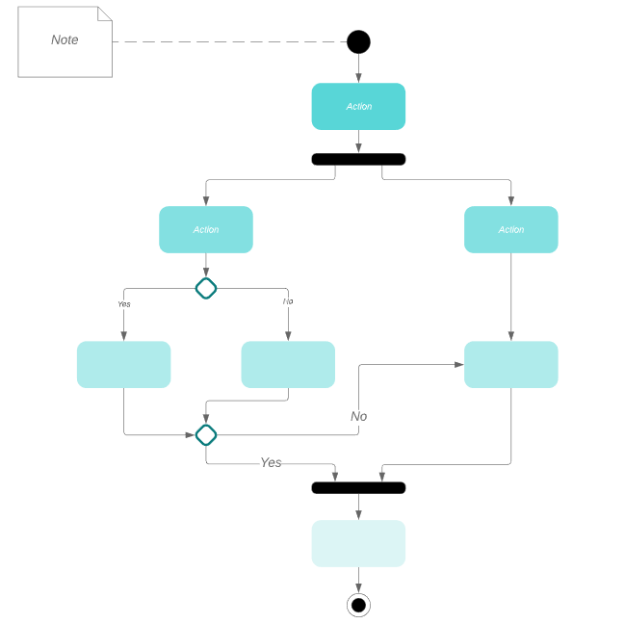
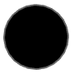
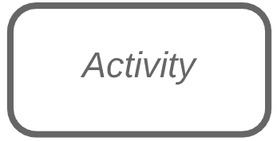

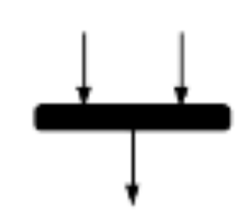
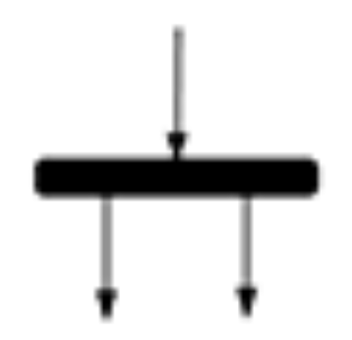
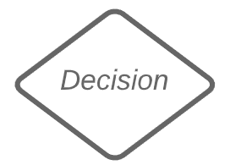

Activity diagram symbols
Symbol | Name | Description
 | Start | Represents the beginning of a process.
 | Activity | Represents the activity that makes up a modelled process
 | Connector | Shows the direction of flow of the activity.
 | Joint | Combines two concurrent activities and re-introduces them to a flow for single activity.
 | Fork | Splits a single activity flow into two concurrent activities.
 | Decision | Represents a decision with at least two paths branching out with condition texts.
 | End | Marks the end of an activity and the completion of all flows of a process.

Slide 4
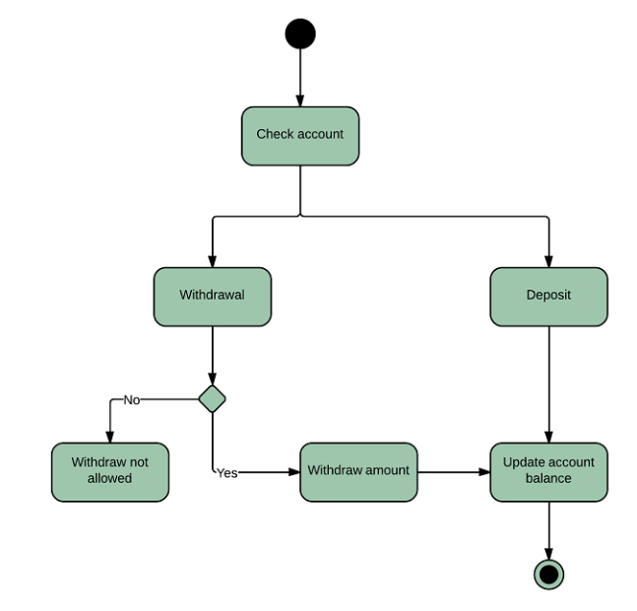
Activity diagram example and task.
Example:
Task:
Create an activity diagram for a POS payment system.
It should accept contactless payment if total amount due is less than £30 else card should be inserted to the machine.
If card is inserted, it should check for the correctness of the PIN.
At the end of a successful transaction, it should ask if customer needs a receipt and respond appropriately.

Slide 5
Structured Programming
Structured programming is aimed at improving the clarity, quality and development time of a computer program.
It makes extensive use of the structured control flow constructs such as selection (if/then/else statements), repetition (while and for loops), block structures (sequence) and sub routines.
This makes codes easier to follow when compared with simple tests and jumps such as go to statements.

Slide 6
Concepts in Structured Programming – Sequence.
Everyday life example:
Sequence: Execute a list of statements in order.
Example: Baking Bread
Add flour.
Add salt.
Add yeast.
Mix.
Add water.
Knead.
Let rise.
Bake.
Programming example:
Sequence: Lines or blocks of code are written and executed in sequential order.
Example:
x = 5
y = 11
z = x + y
WriteLine(z)

Slide 7
Concepts in Structured Programming – Repetition.
Everyday life example:
Repetition: Repeat a block of statements while a condition is true.
Example: Washing dishes
Stack dishes by sink.
Fill sink with hot soapy water.
While moreDishes
Get dish from counter,
Wash dish,
Put dish in drain rack.
End While
Wipe off counter.
Rinse out sink.
Programming example:
Repetition: Repeat a block of code (Action) while a condition is true. There is no limit to the number of times that the block can be executed.
Example:
x = 2
While x < 100
WriteLine(x)
x = x * x
End

Slide 8
Concepts in Structured Programming – Selection.
Everyday life example:
Selection: Choose at most one action from several alternative conditions.
Example: Sorting mails
Get mail from mailbox.
Put mail on table.
While moreMailToSort
Get piece of mail from table.
If pieceIsPersonal Then
Read it.
ElseIf pieceIsMagazine Then
Put in magazine rack.
ElseIf pieceIsBill Then
Pay it,
ElseIf pieceIsJunkMail Then
Throw in wastebasket.
End If
End While
Programming example:
Selection: Repeat a block of code (Action) while a condition is true. There is no limit to the number of times that the block can be executed.
Example:
If n = 1 Then
WriteLine("One")
ElseIf n = 2 Then
WriteLine("Two")
ElseIf n = 3 Then
WriteLine("Three")
Else
WriteLine("Many")
End If

Slide 9
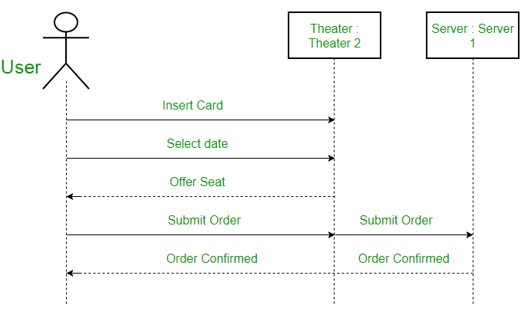
Sequence Diagrams
They depict interaction between objects in sequential order.
They are used for representing the logic and completeness of a usage scenario.

Slide 10
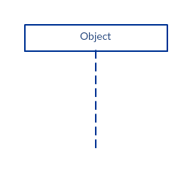
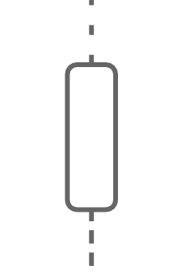




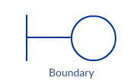
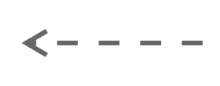
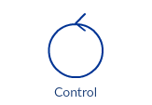

Sequence Diagram - Symbols
Symbol | Description (Lifeline Notations)
 | Object - represents different objects or parts that interact with each other in the system during the sequence.
 | Actor – is used when a particular sequence diagram is owned by a use case
 | Entity – represents system data.
 | Boundary – represents a system boundary such as databases or user screens
 | Control – indicates a controlling entity or manager. Serves as a mediator between entities and boundaries.
Symbol | Description
 | Activation bars – is used to indicate that an object is active during an interaction between two objects. The length indicates the duration of the objects staying active.
 | Synchronous message – is used when the sender waits for the receiver to process the message and return before carrying on with another message.
 | Asynchronous message – is used when the sender does not wait for receiver to process the message before sending other messages to other objects.
 | Return message – is used to indicate that the receiver is done processing the message and is returning control to the caller
 | Destruction occurrence specification – is used to delete a participant that is no longer needed

Slide 11
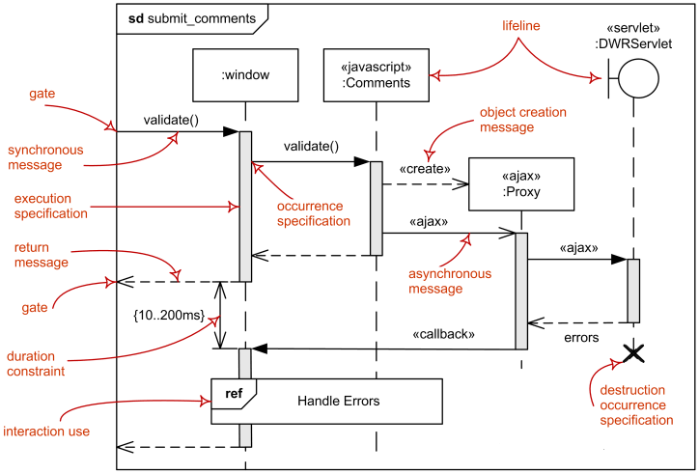
Terms Used in Sequence Diagrams

Slide 12
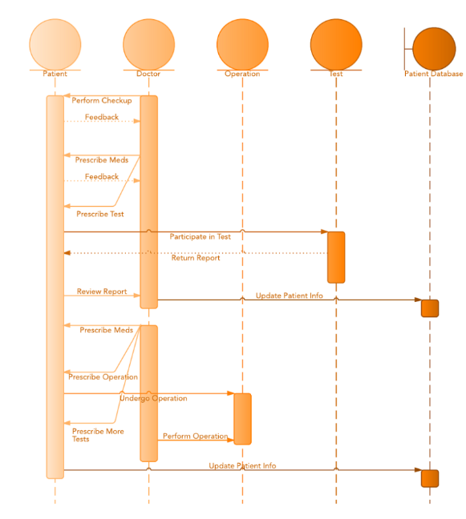
Sequence Diagram – Example and task
Example:
Task: Using the POS scenario given in the activity diagram task, create a sequence diagram with the following details:
Create the user as an actor, the POS as an entity, a control that verifies the pin and updates the database when the transaction is successful.
Create the database as a boundary and show all the events and responses with the appropriate arrow.

Slide 13
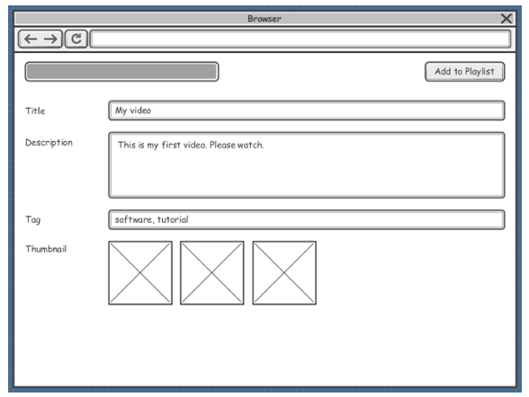
User Interface and Test Modelling – Wireframe.
Wireframe is a sketch of the system to be built. They are used to lay out content and functionality of a page taking into account user needs and use.
The actual screen design is based on the wireframe.
Connectors are used to describe relationships and directionality among views.

Slide 14
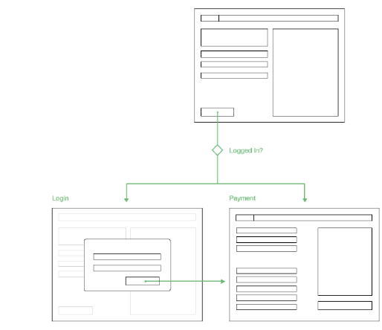
User Interface and Test Modelling – Wireframe.
Example:
Task : For the stated POS payment problem, develop a wireframe mockup model for at least four user interfaces, this should include the initial page, the incorrect pin page, the transaction approved page and the page asking if receipt is needed.

Slide 15
Any Questions?

